Slide 1
Digital Image Processing
Lecture 6:
Ch3:Image Enhancement in the Spatial Domain:
3:6 Smoothing Spatial Filters
3:7 Sharpening Spatial Filters
Dr. Hossam Mahmoud Moftah
Assistant professor – Faculty of computers and information –
Beni Suef University

Slide 2
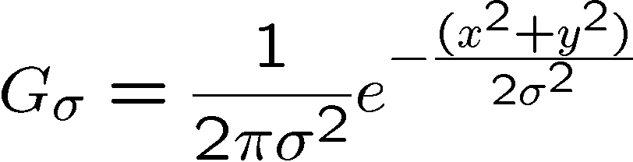
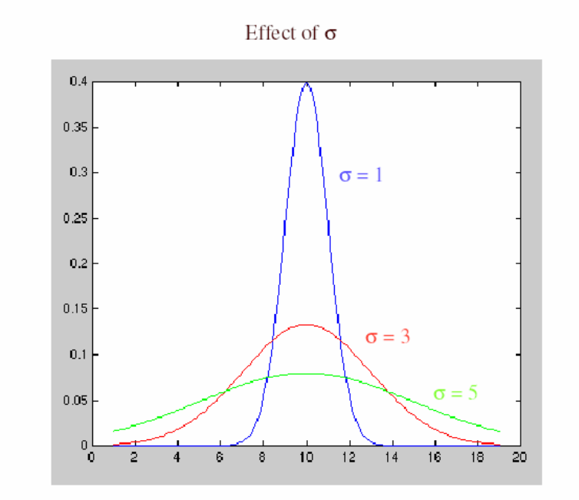
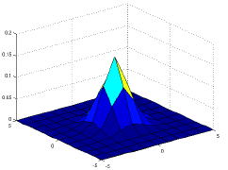
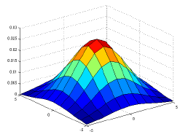


Smoothing Spatial Filters -Gaussian filter- examples
Gaussian distribution
Gaussian distribution for and corresponded Gaussian kernels of the size 11X11.

Slide 3
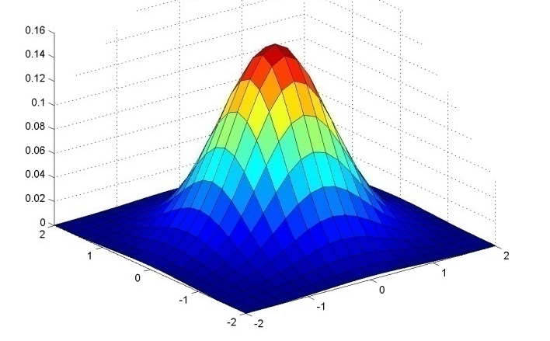
Gaussian Kernel
0.003 0.013 0.022 0.013 0.003
0.013 0.059 0.097 0.059 0.013
0.022 0.097 0.159 0.097 0.022
0.013 0.059 0.097 0.059 0.013
0.003 0.013 0.022 0.013 0.003
5 x 5, σ = 1

Slide 4
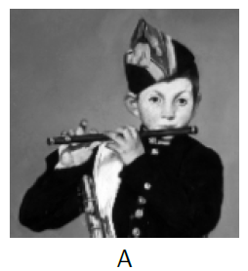
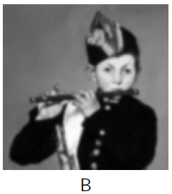
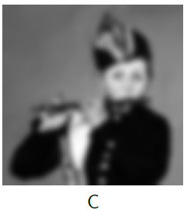

Gaussian filter-examples
A: Input image;
B: Gaussian filter size
11X11 with
C: Gaussian filter size 11X11 with

Slide 5
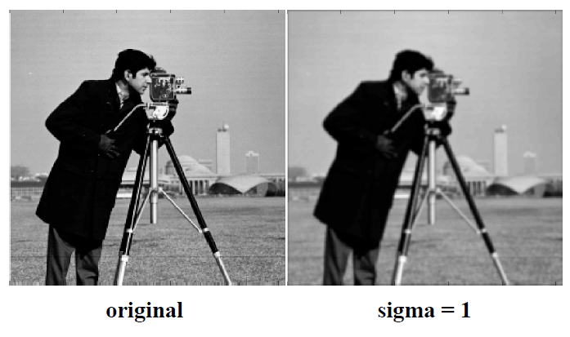
Gaussian filter-examples

Slide 6
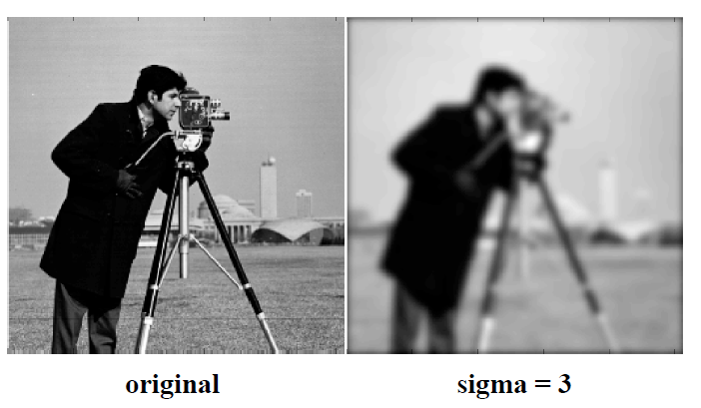
Gaussian filter-examples

Slide 7
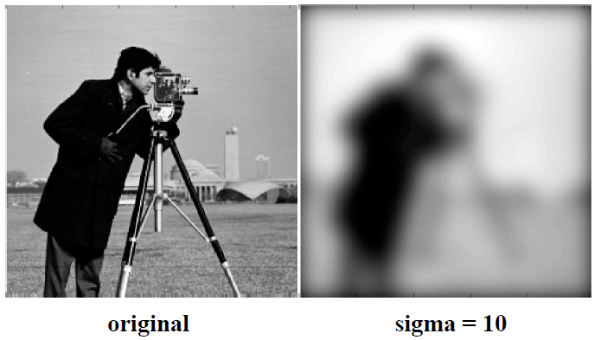
Gaussian filter-examples

Slide 8
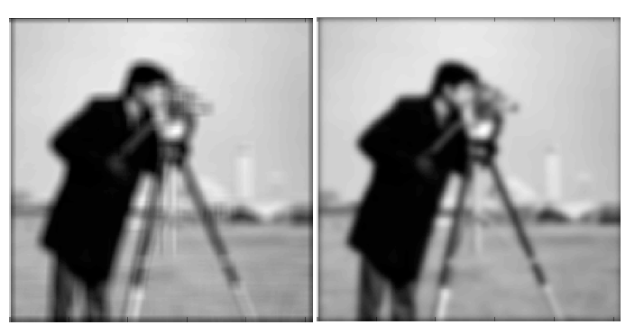
Gaussian filter-examples
Average
Gaussian

Slide 9
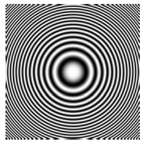

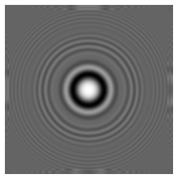

Comparison between Gaussian and Mean filter
Input image;
Gaussian filter
Mean filter
Gaussian and
Mean filter together

Slide 10
Linear Spatial Filtering Implementation using MATLAB
h = fspecial(type)
h = fspecial(type, parameters)
Example: h = fspecial('gaussian', hsize, sigma)

Slide 11
Linear Spatial Filtering Implementation using MATLAB
The toolbox implements linear spatial filtering using function imfilter, with the following syntax:
g = imfilter (f, h, filtering_mode, boundary_option, size_option);
This function filters the multidimensional array f (image) with the multidimensional filter h (filter mask). The result g (filtered image) has the same size and class as f.

Slide 12
Linear Spatial Filtering Implementation using MATLAB
Filtering_mode:
Option Description
--------- ---------------
‘Corr’ imfilter performs multidimensional filtering using correlation (default option)
‘Conv’ filtering is done using convolution

Slide 13
Nonlinear (Order-Statistic) filters
Takes the median of the values in some neighbourhood
Better than mean (linear filters) for some noise models
Preserves edges slightly better than linear filters
Based on ordering (ranking) the pixels contained in the filter mask
Replacing the value of the center pixel with the value determined by the ranking result
E.g., median filter, max filter, min filter

Slide 14
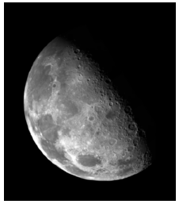
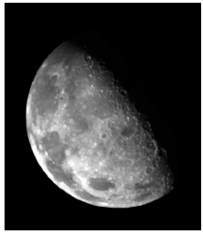
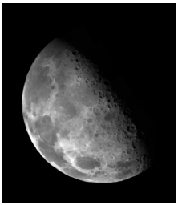
Max and Min filter
Max filter- The maximum value replaces the current pixel
  brighter image
Min filter- The minimum value replaces the current pixel
  darker image
Original image;
Max filter with
3X3 kernel
Min filter with 3X3 kernel.

Slide 15
Median filter
Good for impulsive noise
  =>Noise is reduced
  => Sharp edges are kept as no new values are created
  => Dominating areas become more dominating; very thin lines and sharp corners are damaged
  => Time-consuming to sort values compared to average values
Applying median filtering iteratively is an efficient smoothing
By choosing other shapes than rectangular neighbourhoods (thin lines may be preserved)

Slide 16
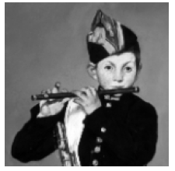
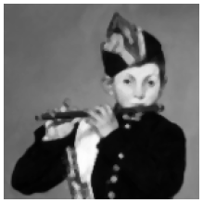
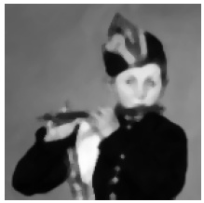
Median filter- examples
Median filter size
3X3;
Input image;
Median filter size
5X5.

Slide 17
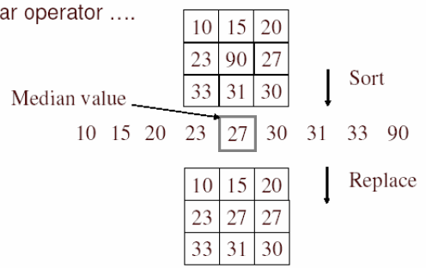
Median filter- examples
A median filter operates over a window by selecting the median intensity in the window
Notes:
Linearity of median filter: try filter([0 0 0; 0 1 0; 0 0 0] + [1 1 1; 1 1 2; 2 2 2])

Slide 18
Median filter- examples
Replace each pixel by the median over N pixels (5 pixels, for these examples). Generalizes to “rank order” filters.
In:
Out:
Spike noise is removed
5-pixel neighborhood
Monotonic edges remain unchanged

Slide 19
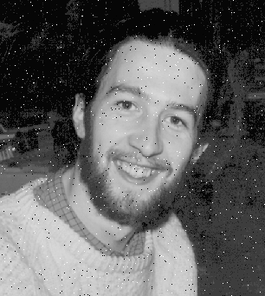

Median filter- examples
Best for salt and pepper noise

Slide 20
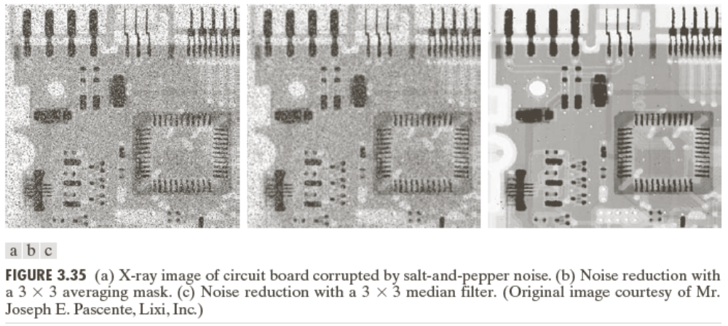
Median filter- examples

Slide 21
Sharpening Spatial Filters
Foundation
Laplacian Operator (Lab Assignment using python)
Unsharp Masking and Highboost Filtering
Using First-Order Derivatives for Nonlinear Image Sharpening
  Robert Cross Gradient Operator
  Sobel Operator (Lab Assignment using python)
  Prewitt operator (Lab Assignment using python)

Slide 22
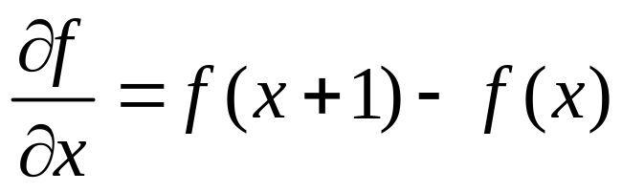
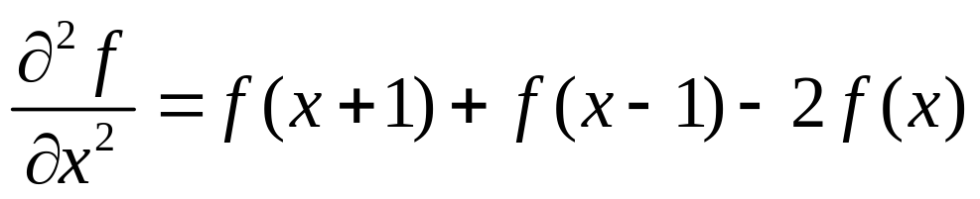
Sharpening Spatial Filters: Foundation
The first-order derivative of a one-dimensional function f(x) is the difference
The second-order derivative of f(x) as the difference

Slide 23
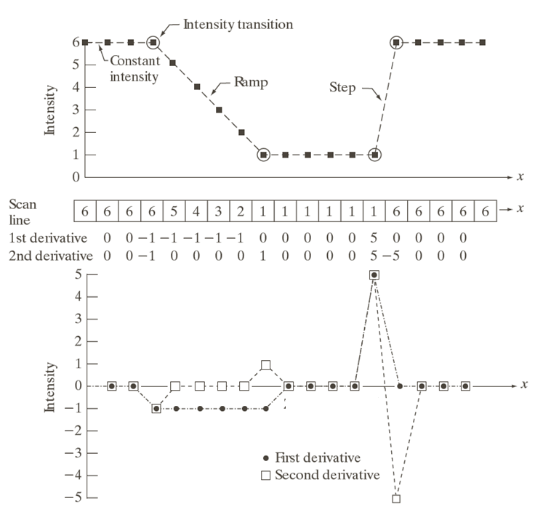
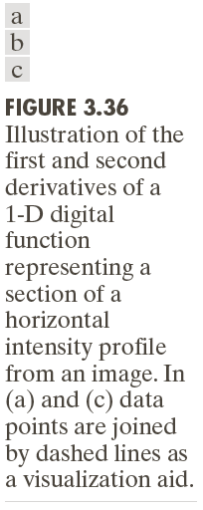

Slide 24
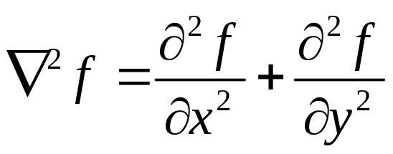
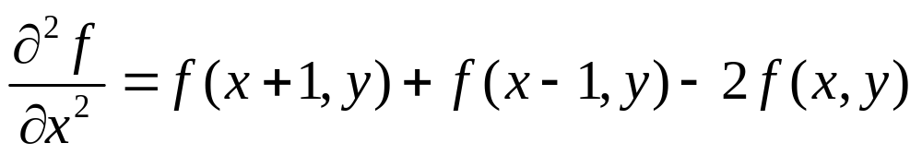
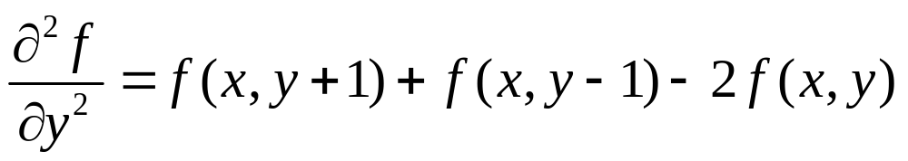
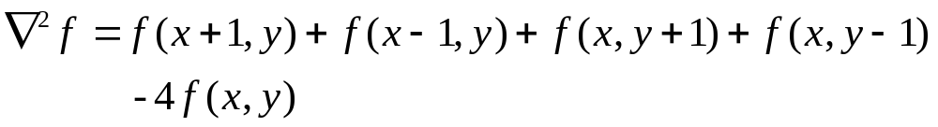
Sharpening Spatial Filters: Laplace Operator
The second-order isotropic derivative operator is the Laplacian for a function (image) f(x,y)

Slide 25
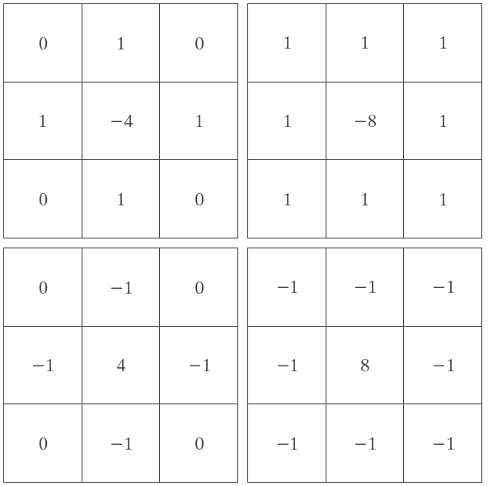
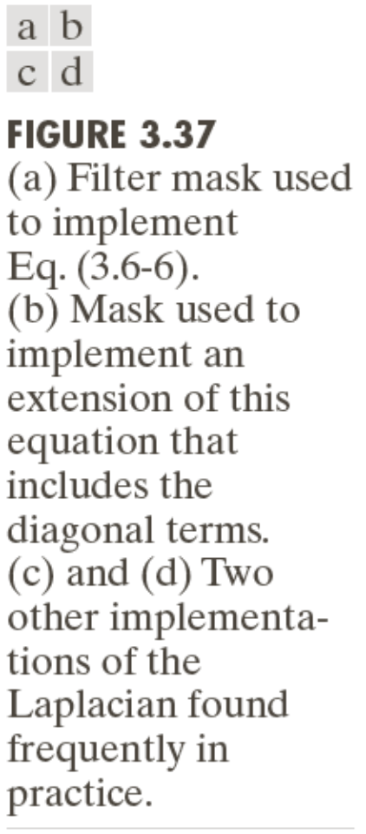
Sharpening Spatial Filters: Laplace Operator

Slide 26
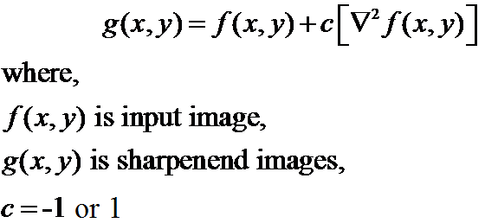
Sharpening Spatial Filters: Laplace Operator
Image sharpening in the way of using the Laplacian:

Slide 27
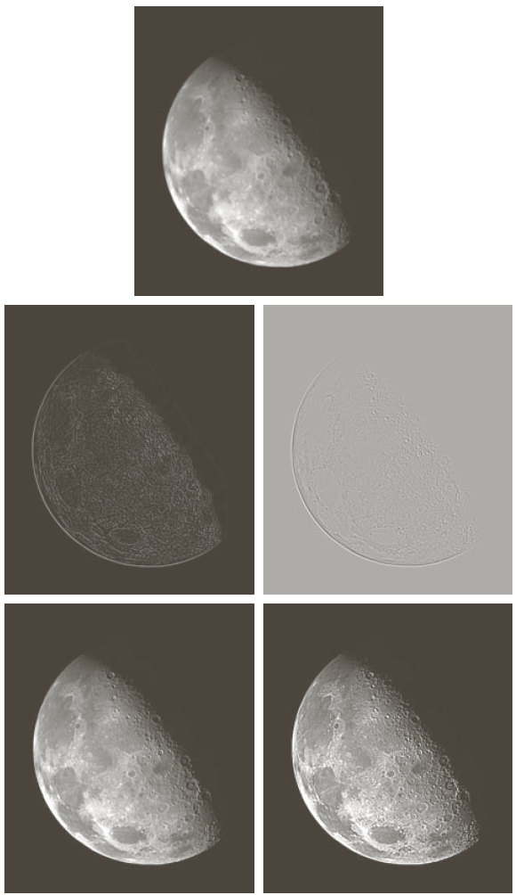
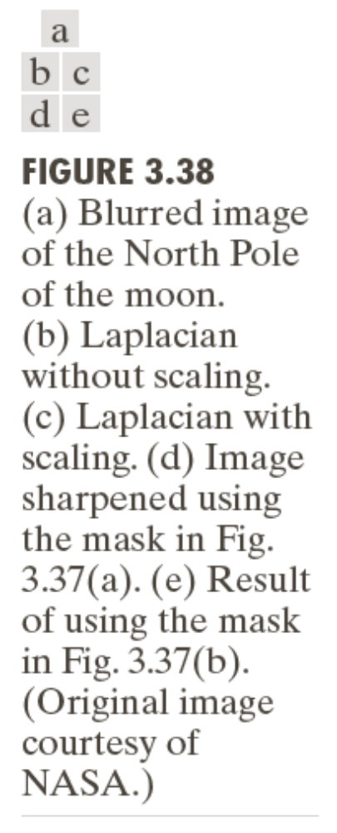

Slide 28
The end

